Slide 1
Vehicle Architecting for « ACES »
Introduction

Slide 2
Digital transformation in the automotive industry – ACES
Four major disruptions
Autonomous vehicles → cars will be fully autonomous, basically no driver.
Connected vehicles → cars will become more connected, thus enabling a variety of use cases
Communication with traffic-management cloud solutions to receive traffic updates and to download the latest high-definition maps.
Communication with other cars to gain the latest information on slippery roads or potholes (V2X)
In-vehicle media streaming is becoming common practice and will require mobile-network operators to build high-bandwidth network solutions across highways and in city centers.
Electrification → cars will increasingly feature electric powertrains to reduce/eliminate emissions.
Shared mobility → cars will have multiple users and consumers will be able to monetize their idle cars.
The name of the game for car OEMs is simple: SURVIVAL OF THE FITTEST. Only those which will be able to transform at the right pace will survive 🡪 From cars manufacturers to mobility service providers (https://www.youtube.com/watch?v=e2rBzJXLem8).

Slide 3
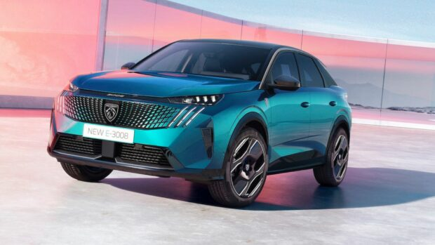
WHAT DO YOU KNOW ABOUT AUTOMOTIVE INDUSTRIES ?
Major TRENDS of AUTOMTATIVE INDUSTRY
HISTORIC COMPONENTS
AUTONOMOUS TRENDS
MULTIMEDIA TRENDS
CONNECTIVITY TRENDS
Jobs around the vehicle
Supplier trends
Software trends
EE Architecture trends

Slide 4
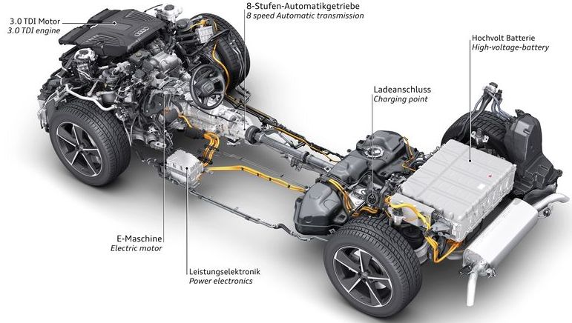
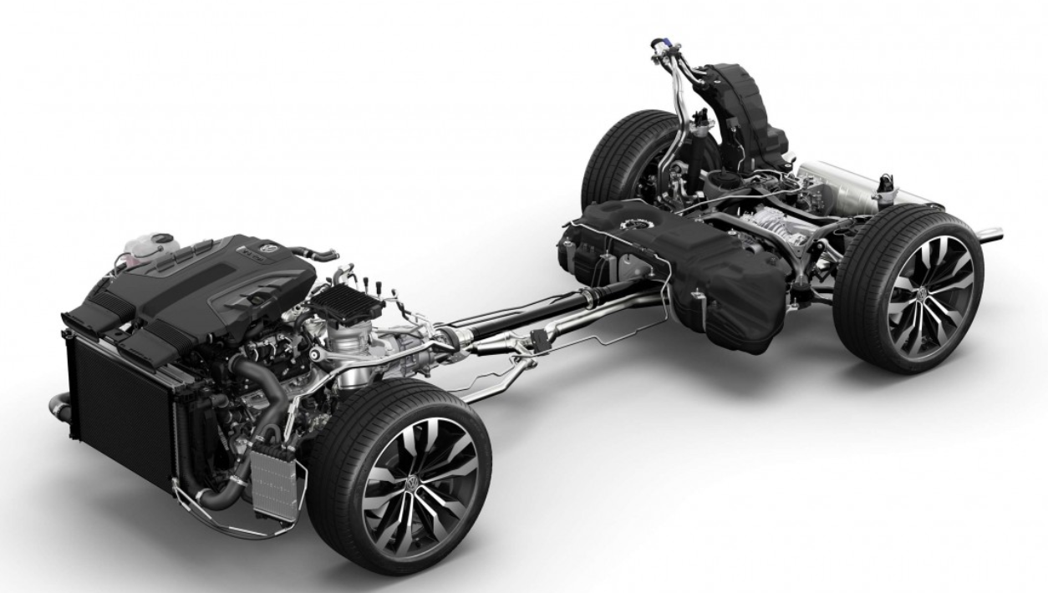
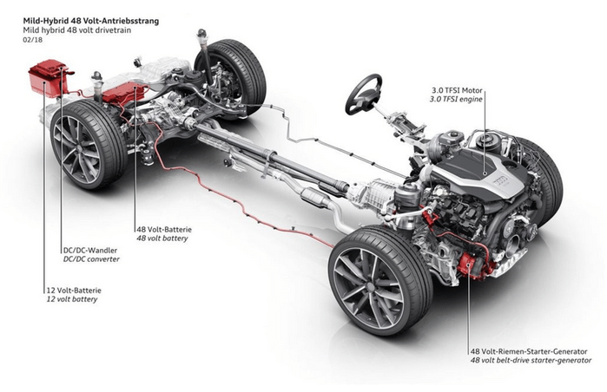
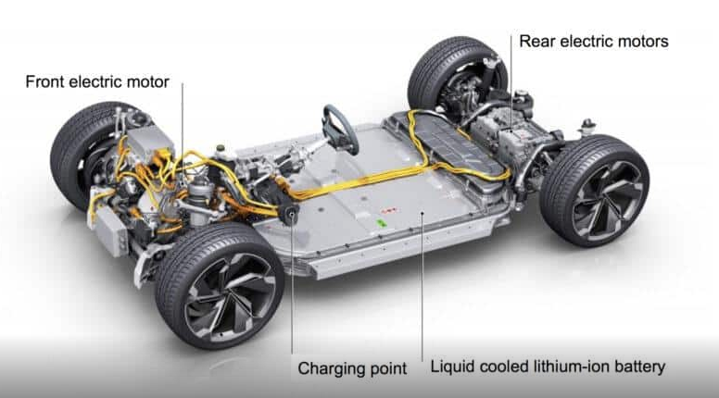
What is the Architecture ? - Major components of the vehicle
ICE
Plug-in Hybrid
Mild-Hybrid
BEV

Slide 5
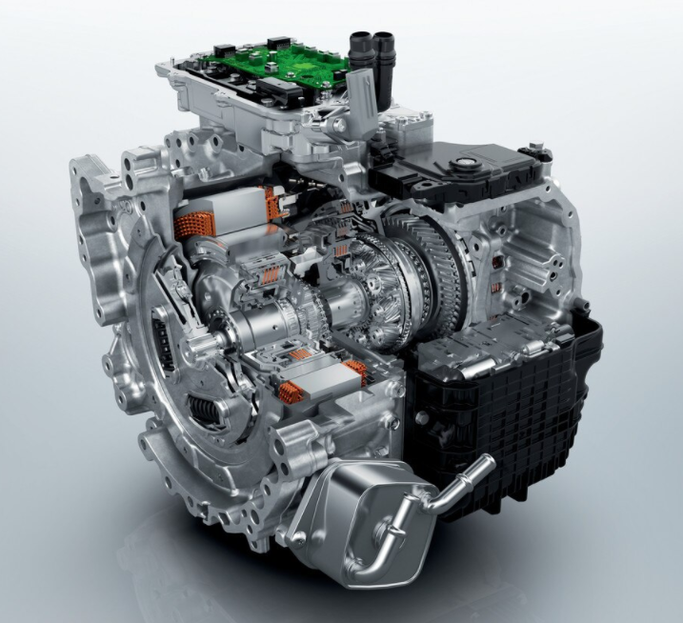
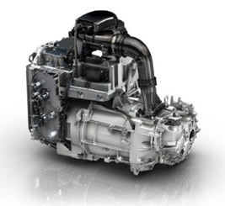
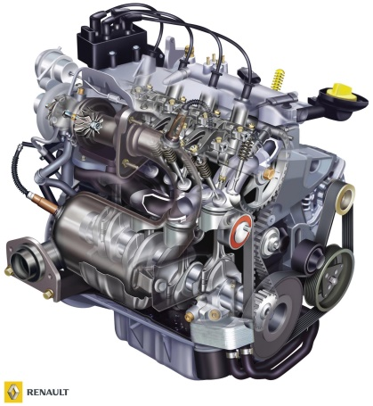
What is the Architecture ? - Major components of the vehicle
Electric Motor
ICE Motor
Hybrid Motor

Slide 6
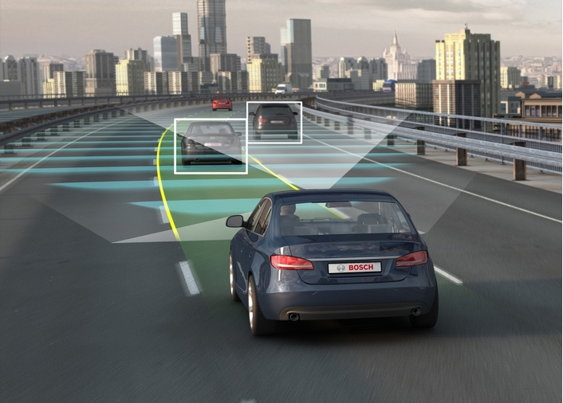
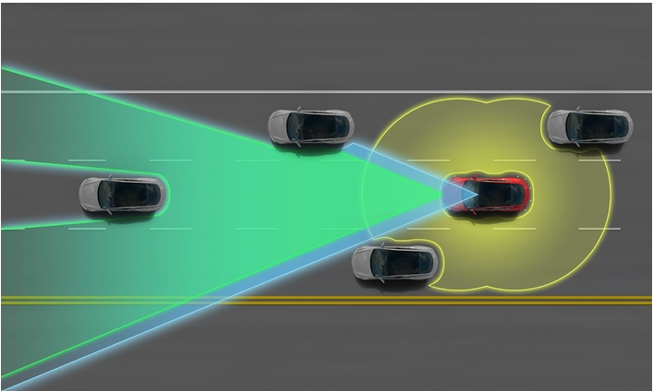
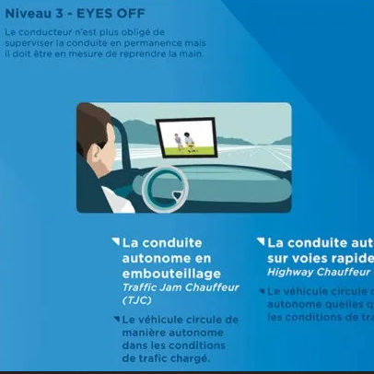
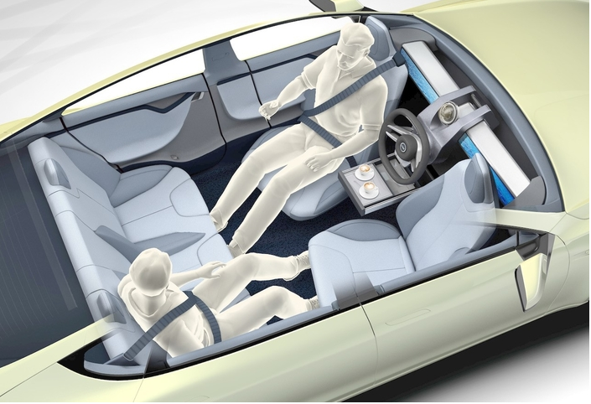
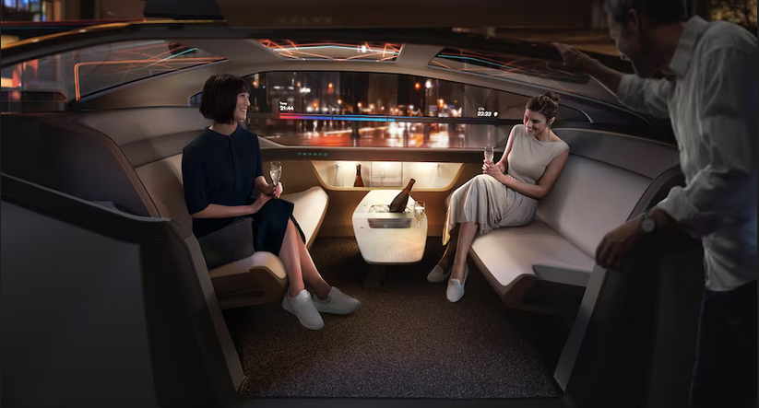
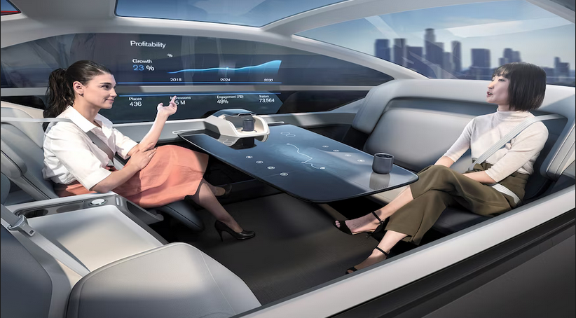
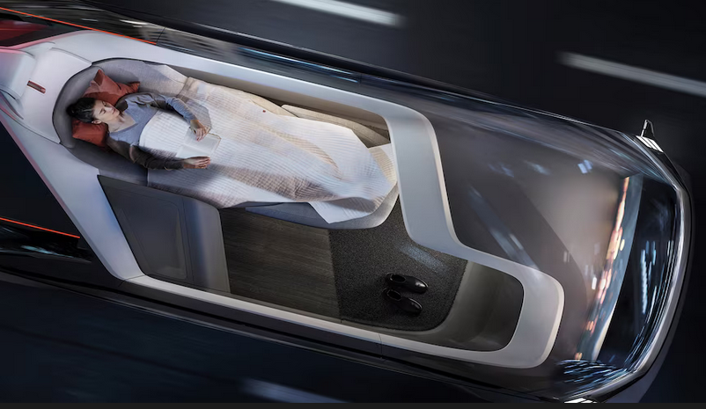
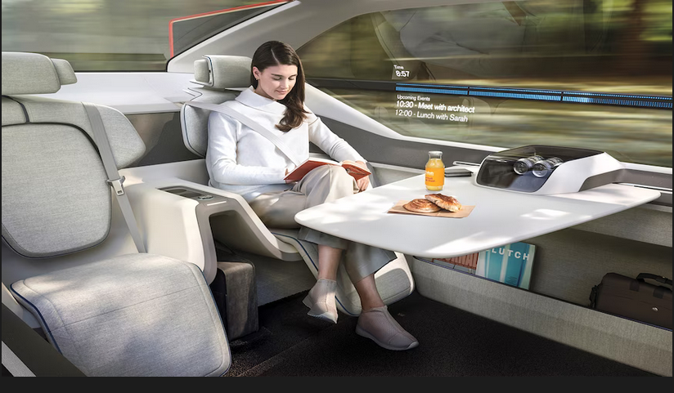
What is the Architecture ? – AUTOMATION TRENDS
2018
2020
Feet off
Hands off
Eyes off
2016
Level 1 : BSD, AFIL, AEB,ACC, LKA, LPA Park assist etc.
Level 2-joint Driving : HIA, Stop in lane, DAA4,CPK4
Level 3 : TJC,HC, CPK5
2025
Mind off
driverless
>2025
Level 4 : driver does other things during some driving phase
Level 5 : full automation

Slide 7
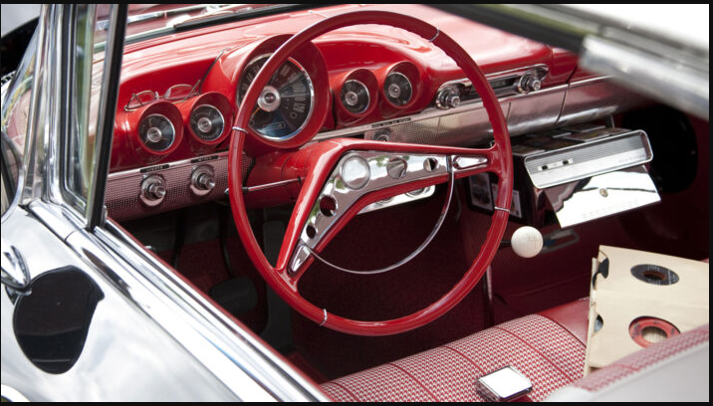
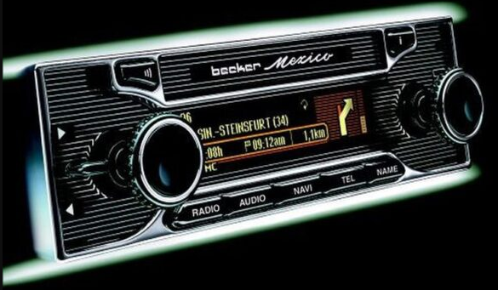
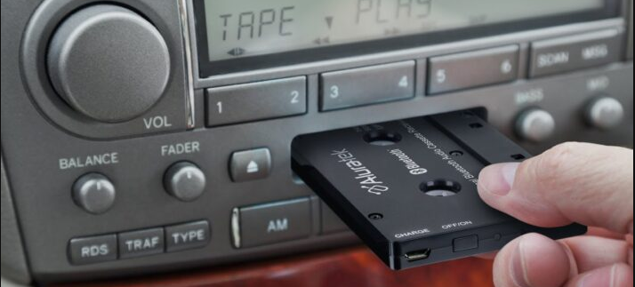
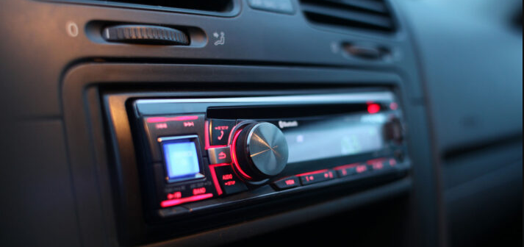
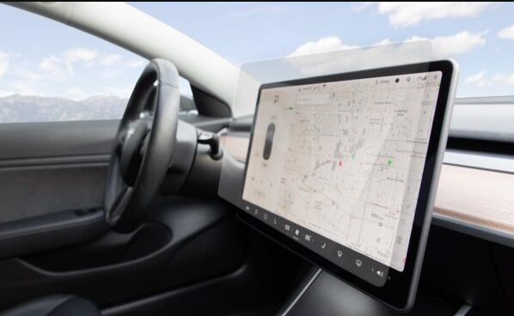
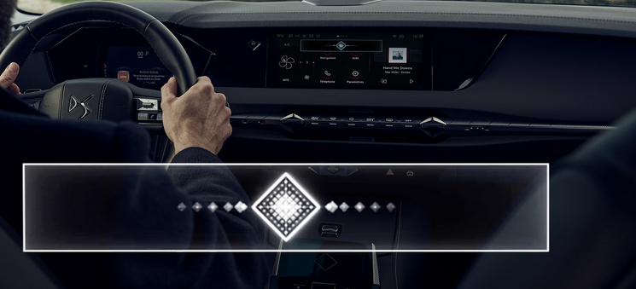
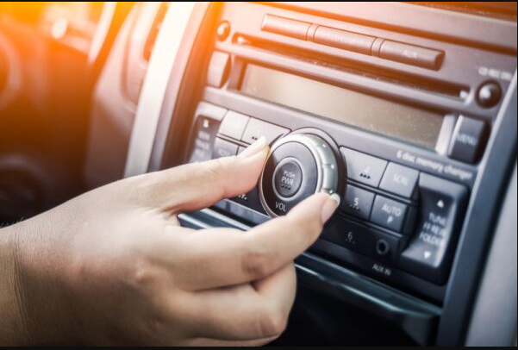
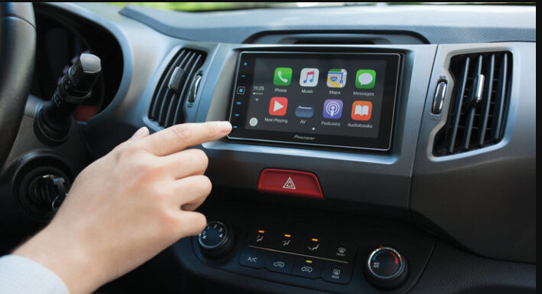

What is the Architecture ? - Major components of the vehicle
1930’s : AM radio
1940’s –1950’s : Radio preset switchs and knobes between channel
1960’s-1980s : cassette tapes
1990’s : CDs
2010s : Touch screens, android auto, apple carplay, applications, wifi, GPS
Today : internet connectivity, 3D, smart navigation, augmented reality
2000’s : Mp3, Ble, hands free
Automotive industry follows the multimedia trends

Slide 8



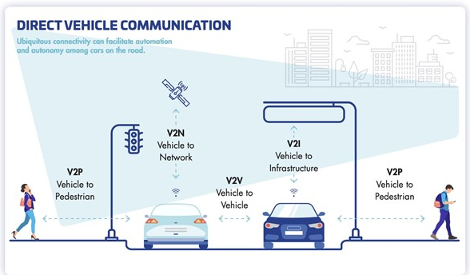
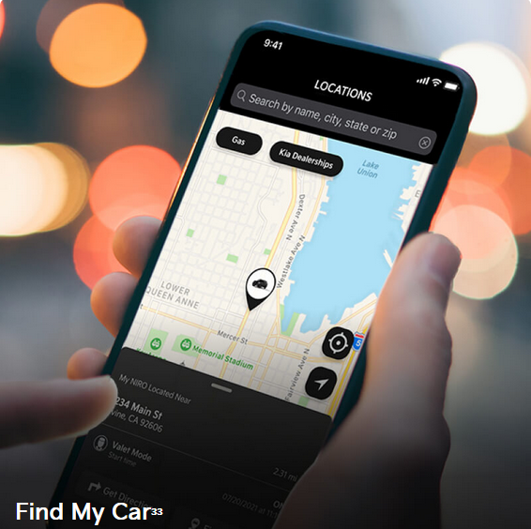
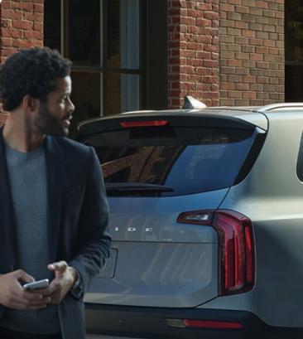

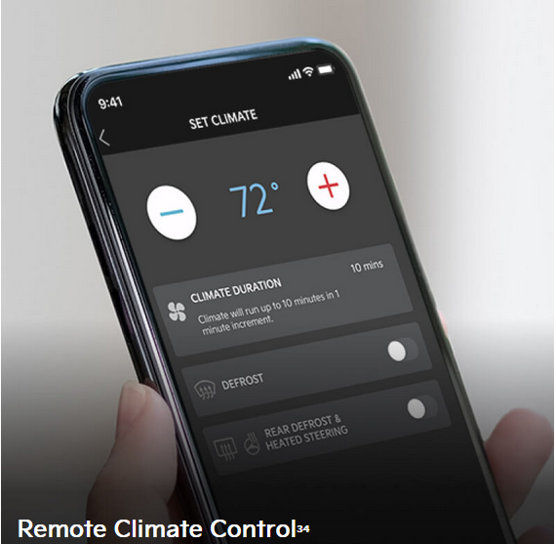



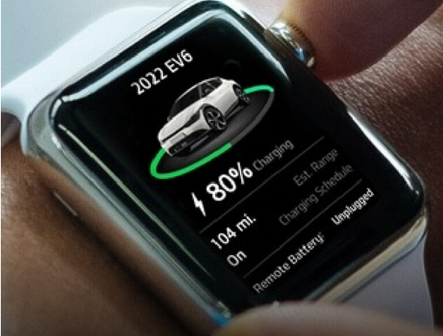
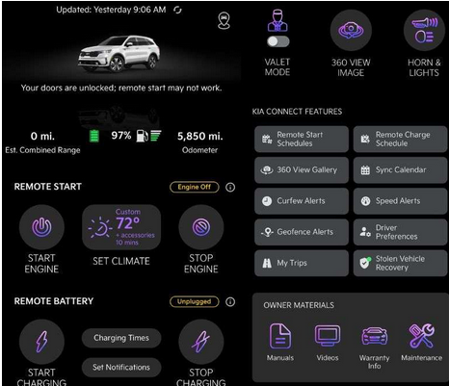
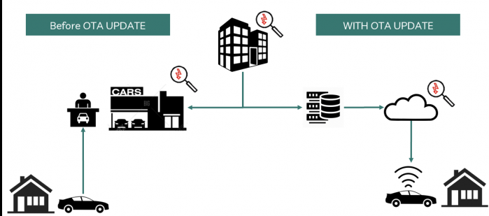
CONNECTIVITY TRENDS
1998
2005
Emergency Assistance
Multimedia sharing, navigation sharing
2015
1996
Vehicle interaction with smart device
Assistance of driver
Future of connectivity
2018
2016
Vehicle to objects, more remote information, range, trips, recharge etc.
Vehicle update
Notes:
1996 : Onstar ➔ Assistance of the customer
1998 : ecall ➔ in case of accident
2005 : AudiConnect ➔ Interraction btw smartphone and vehicle (LTE, traffic information)
2015 : Other fa

Slide 9
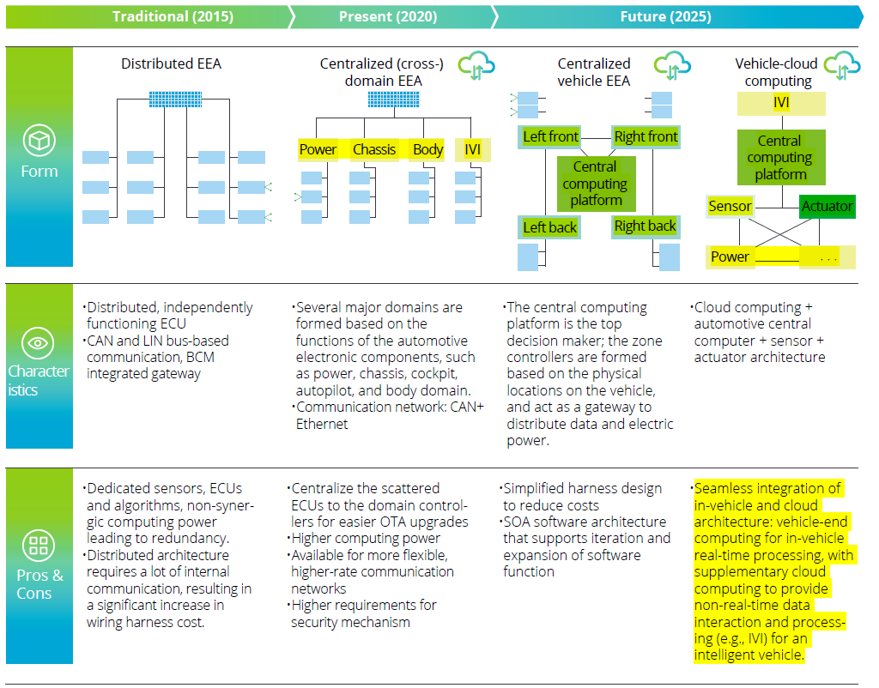
ELECTRICAL & ELECTRONICAL TRENDS

Slide 10
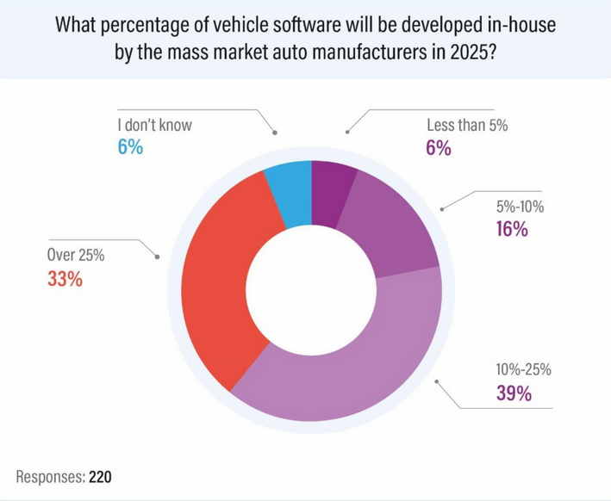
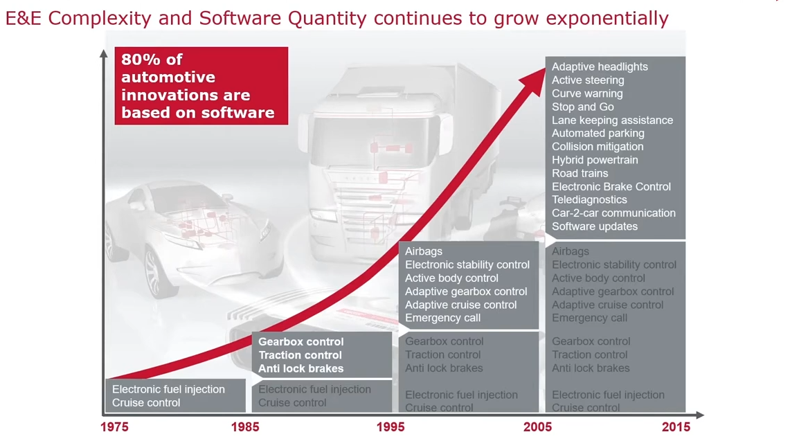
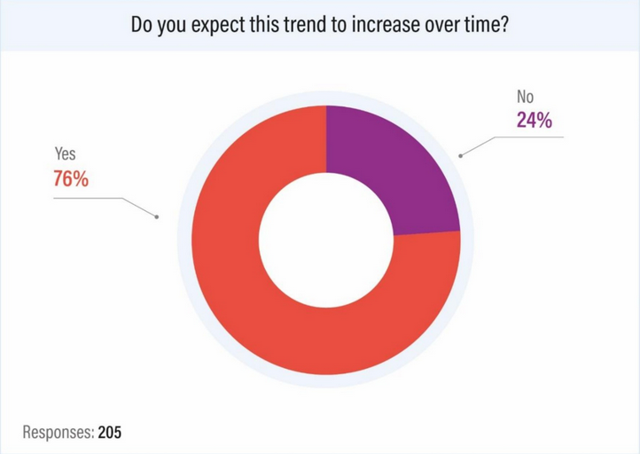
SOFTWARE TRENDS
Software has become the preferential mean to manage vehicle operations, add and enable new vehicle features → Software-Defined Vehicle
https://www.auroralabs.com/the-2020-automotive-software-survey-report/
https://www.strategyanalytics.com/access-services/automotive/autonomous-vehicles/complimentary/report-detail/the-2020-automotive-software-survey

Slide 11
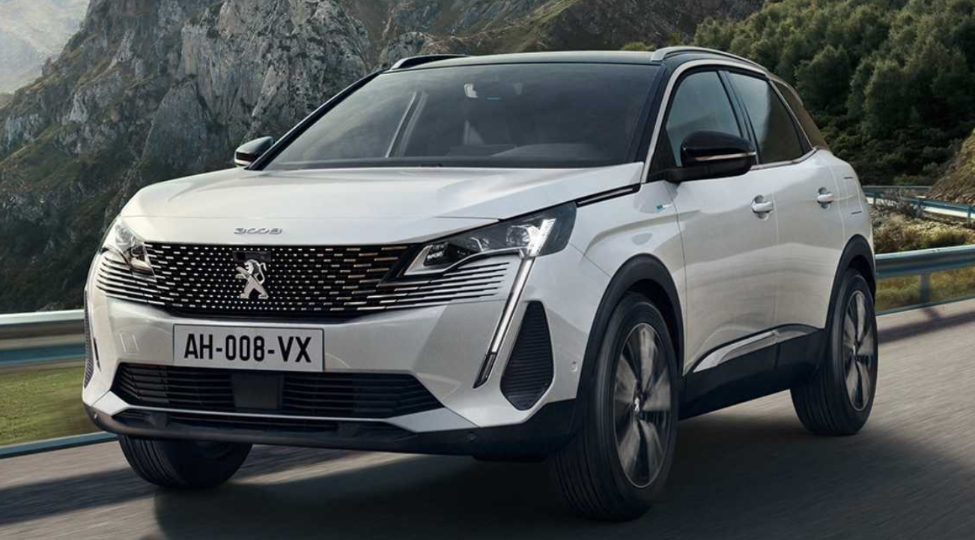
What is the Architecture ? – Jobs around the vehicle
Design
- Research engineer
- Embedded system engineer
- Powertrain engineer
- Ergonomist
- Style
- Test driver
- Mechatronic engineer
- Safety engineer
- Software engineer
- Cyber engineer
- Data analysis, data scientist
Manufacture
- Manufacturing engineer
- Machinist, tool and die maker
- Quality engineer
- Process engineer
- Technicians: Welder, painter, etc.
Repair
- After sales operator
- Diagnosis operator
- Sheet metal worker
- Workshops
Sell
- Seller
- Product manager
- Sales manager
- Influencer
- Transporter

Slide 12
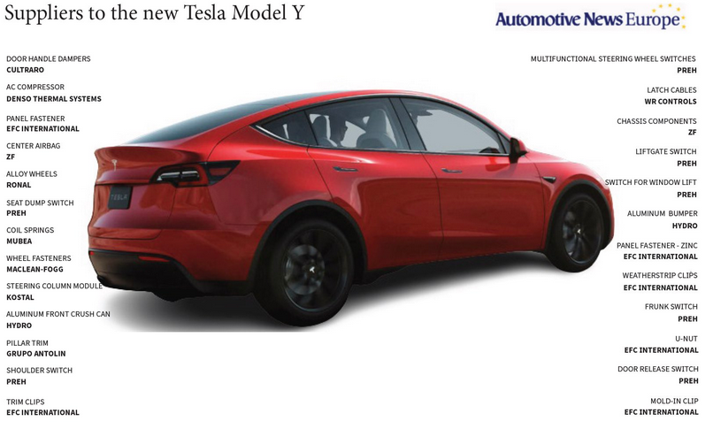
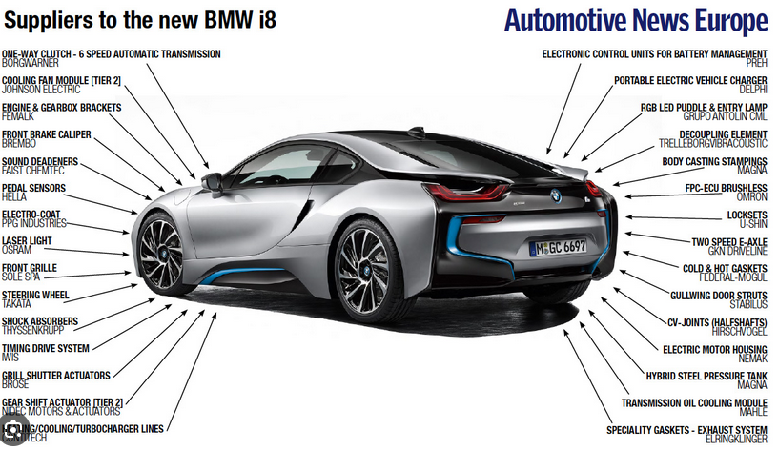
What is the Architecture ? -
Tesla
Generalist Carmaker

Slide 13
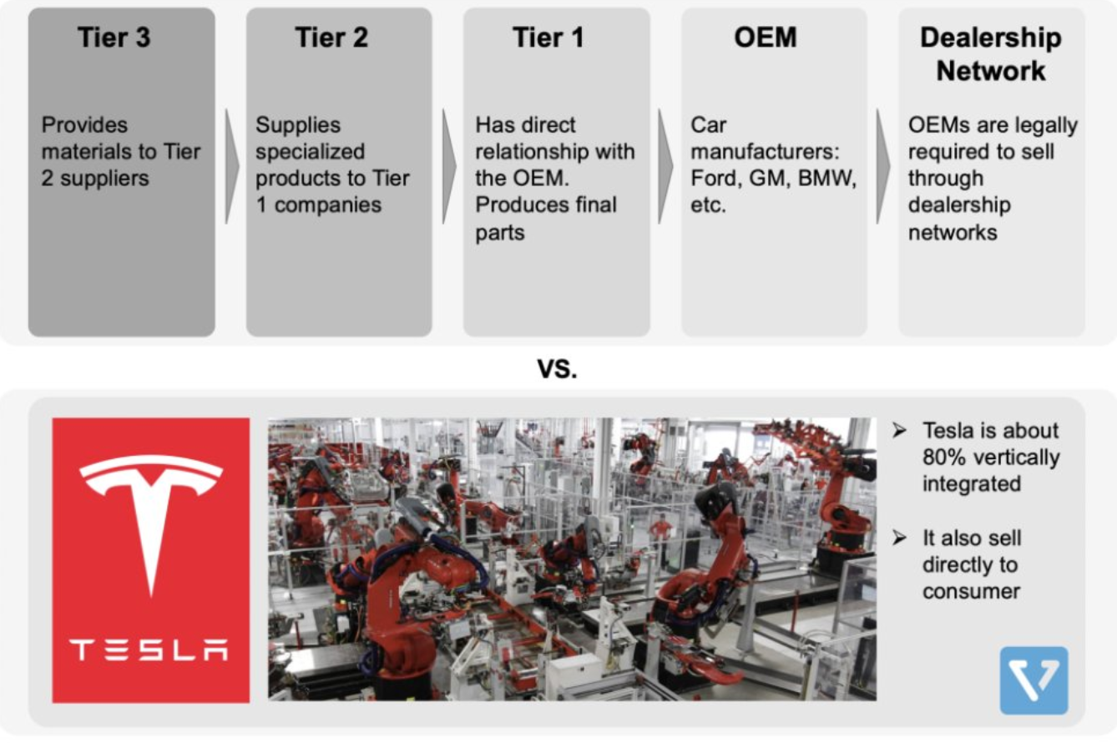
What is the Architecture ? – Supplier trends
Before 2020
Since 2020

Slide 14
What is the Architecture ?
Complex systems : several technologies
Articulation of several jobs
Complex & evolutive environment

Slide 15
What is the Architecture ? - Vocabulary
Build
Consistency
Plan
Frame
Order
Gather
Configure
Frame
Put together
Guide
Organise
Compose
Link
Cadre
Group
Put in order
Categorize
structure

Slide 16
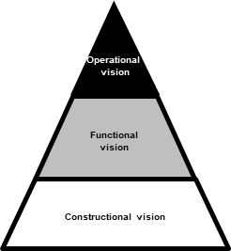
What is the architecture - Conclusion
Constructional Vision
Steering wheel
seats
Engine
Wheel
gearbox
pedals
boot
CID
doors
Cameras
Windshield
Usb, WLC
Radar
Us sensors
Rear, front axles
Retro
telematics
HVAC
…
Siren
Functional vision
Transfer NRJ
Detect environment
Provide entertainment
Exchange data
Allow physical access
Reflect the environment
Operational
vision
Travel
Reduction of road accident
ecologist
Entertainement
Ease life

Slide 17
Class format & grading principles
Typical class session organisation
Presentation of state of progress by each group : 45 – 60 minutes
coaching by the lecturers
Send the state of progress by email each end of Week (Friday)
Grading
In-class practicing: 40%
Final assessment : 60%
QCM
Poster presentation : A2
The endgame: demonstrating that you have understood the automotive business mutations, explored the new use-cases induced by the digital transformation and societal evolutions and posed as a vehicle system architect facing all those challenges and devising systems solutions to answer those new needs.

Slide 18
Topics
Electrical & Software platform
Cybersecurity and antitheft in connectivity context (1)
Vehicle enhancement
Make Automotive experience similar to smartphone experience (2)
Which product line to fit smartphone experience ? (3)
Autonomy and Safety :
vehicle intelligence for road safety (4)
Maintenance :
keeping the vehicle in operational condition, minimizing unavailability (5)
Automotive role in Smart city context :
how to minimize car impact in a city ? (6)
How to convince Citizen to accept the transition(energetic, new mobility, etc.) ? (7)

Slide 19
For next week
Define the problem :
Identify actors of your topic
What are expectations of each actor ? Their concerns ?
Derive the problem you want to solve

Slide 20
ANNEX

Slide 21
Software trends : Software architecture patterns
https://www.mckinsey.com/industries/automotive-and-assembly/our-insights/rewiring-car-electronics-and-software-architecture-for-the-roaring-2020s
https://www.se.rit.edu/~swen-440/reading/Staron%20-%202021%20-%20Software%20Architectures%E2%80%94Views%20and%20Documentation.pdf
https://www.atlassian.com/microservices/microservices-architecture/soa-vs-microservices?utm_source=gdn&utm_medium=paid-display&campaign=21456654650&adgroup=&device=c&devicemodel=&placement=&aceid=&creative=&adtype=&gclid=CjwKCAjw0aS3BhA3EiwAKaD2ZR1qBEfiR1i005m7QkHsv4CtP0rtbH9O-1253yt9MgL_m2_yFUWQHBoCHc4QAvD_BwE&country=&network=x&targetid=&gad_source=1

Slide 22
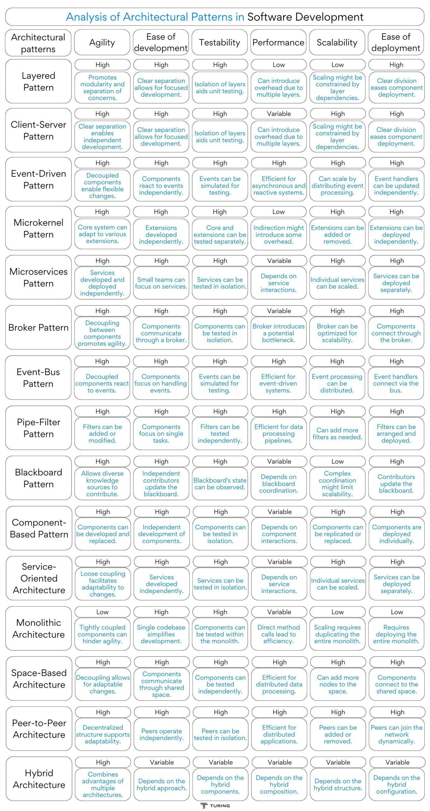
Software trends : Which Software architecture patterns fit in Automotive industry ?
Remote
Infotainment
V2V, V2H, V2G
Infotainment
PAM
Software Architecture Patterns: What Are the Types and Which Is the Best One for Your Project | Turing

Slide 23
EXAMPLE OF AUTOMOTIVE TRENDS
Autonomous vehicle
Highway Chauffeur:
https://www.youtube.com/watch?v=zcgzVEB3llM
https://www.youtube.com/watch?v=ReJOvW094_4
Connectivity
Vehicle maintenance: health and usage monitoring, design to service,…: https://www.youtube.com/watch?v=W-RGZ2zlnVI
In-vehicle entertainment: https://www.youtube.com/watch?v=zwhNeLpk_kU
Data business: https://www.youtube.com/watch?v=8F0LOISII78
Sharing
Car sharing : https://www.youtube.com/watch?v=jZ2wreTEKn4
Vehicle renting new business model : https://www.youtube.com/watch?v=Vzx9_9FkVG8

Slide 24
What is the Architecture ? - QCM
 | Complex systems | Complex environment | Several jobs | Evolutive environment | Is it an Architect ?
Watchmaker
Pilot
Prime minister
Football team manager
Paris mayor

